Slide 1
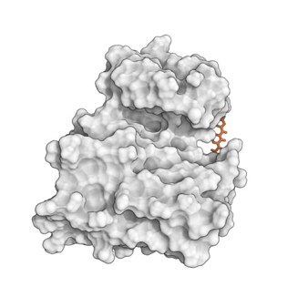
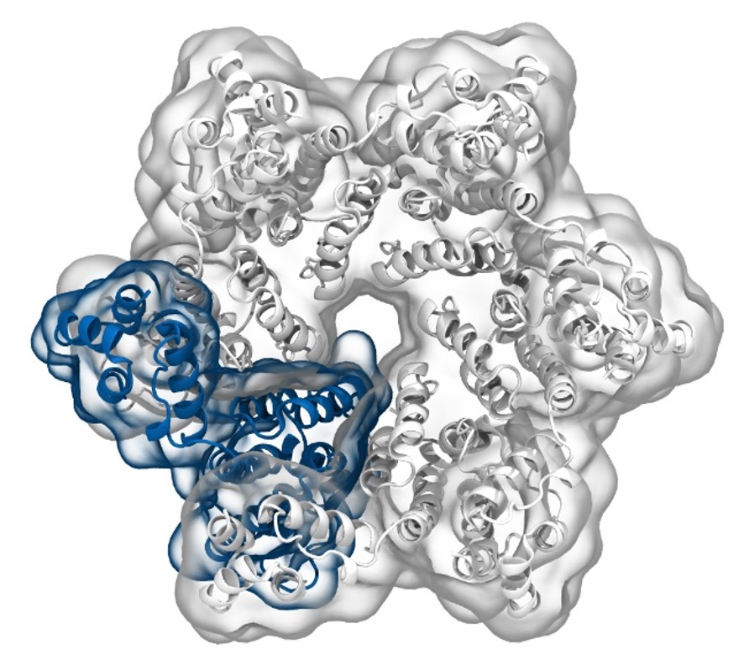
Simulation of Biomolecules
Classification
2024 CCP5 Summer School
Dr Matteo Degiacomi
Durham University
matteo.t.degiacomi@durham.ac.uk
Dr Antonia Mey
University of Edinburgh
antonia.mey@ed.ac.uk

Slide 2

The Data Mining world
From scikit-learn.org
2

Slide 3
The Data Mining world
From scikit-learn.org
3

Slide 4
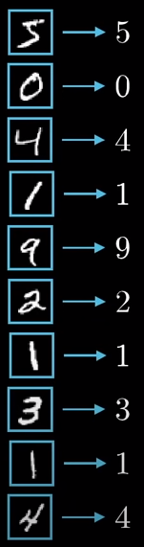
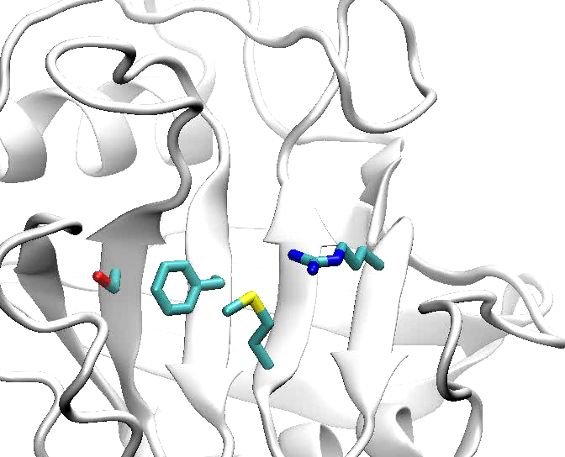
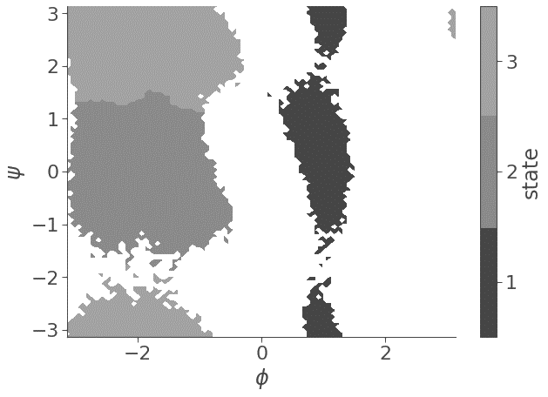
Features are possible ways to represent data
Pixels colour
Torsional angles
Interactomic distances
4

Slide 5
Labels assign featurised data to categories
Labelled digits
[-12008 kJ]
[-12078 kJ]
[-12045 kJ]
[-12083 kJ]
[-12062 kJ]
[-12058 kJ]
.
.
.
[-12099 kJ]
[-12093 kJ]
1
3
2
Labelled states
Labelled Energies
5

Slide 6
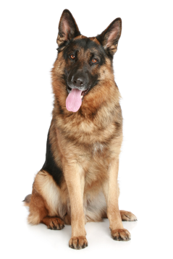
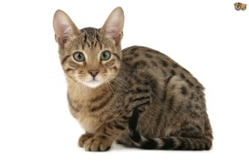

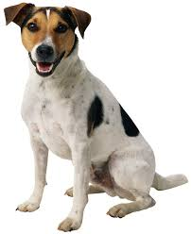
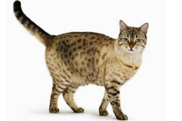
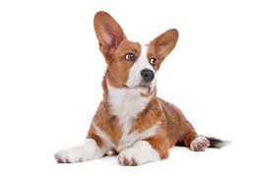
Data Classification via Supervised Learning
take labelled data
create an n-dimensional feature vector from data
Separate «feature space» in different regions
dog
cat
cat
Weight
Legs length
Tail length
Eye color
...
cat
dog
Tail length
dog
dog
cat
Weight
6

Slide 7

Data Classification via Supervised Learning
take labelled data
create an n-dimensional feature vector from data
Separate «feature space» in different regions
dog
cat
?
Weight
Legs length
Tail length
Eye color
...
Dog
Tail length
Weight
7

Slide 8
Data Classification via Supervised Learning
take labelled data
create an n-dimensional feature vector from data
Separate «feature space» in different regions
Warning: a too precise classification of examples might sacrifice generality (overfitting)
dog
cat
?
Weight
Legs length
Tail length
Eye color
...
Cat
Tail length
Weight
8

Slide 9
Data Classification via Supervised Learning
Data
9

Slide 10
Data Classification via Supervised Learning
Training
Validation
Unknown classification
Train ML algorithm
model
Test ML algorithm
10

Slide 11
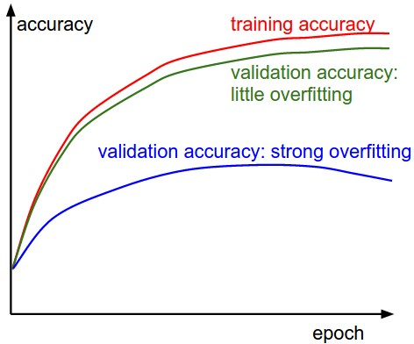
Data Classification via Supervised Learning
Training
Testing
Unknown classification
Train
model
Test
11

Slide 12

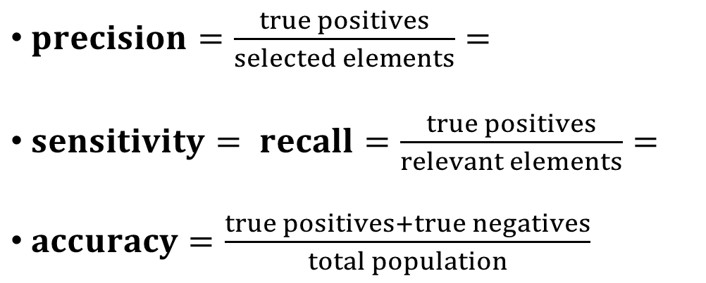
Some terminology
real
 | Dog | Cat
Dog | 90 | 10
Cat | 12 | 88
Confusion Matrix:
describes classification results
can also describe n classes
result
$precision=\frac{true positives}{selected elements}=$
$sensitivity= recall=\frac{true positives}{relevant elements}=$
$accuracy=\frac{true positives+true negatives}{total population}$
en.wikipedia.org/wiki/Precision_and_recall
12

Slide 13
Learning Algorithms
Artificial Neural Network (ANN)
Decision Tree (DT)
Random Forests (RF)
Support Vector Machine (SVM)
Logistic Regression (LOGRES)
Naïve Bayes (NB)
K Nearest Neighbor (KNN)
...
13

Slide 14
Learning Algorithms
Artificial Neural Network (ANN)
Decision Tree (DT)
Random Forests (RF)
Support Vector Machine (SVM)
Logistic Regression (LOGRES)
Naïve Bayes (NB)
K Nearest Neighbor (KNN)
...
14

Slide 15
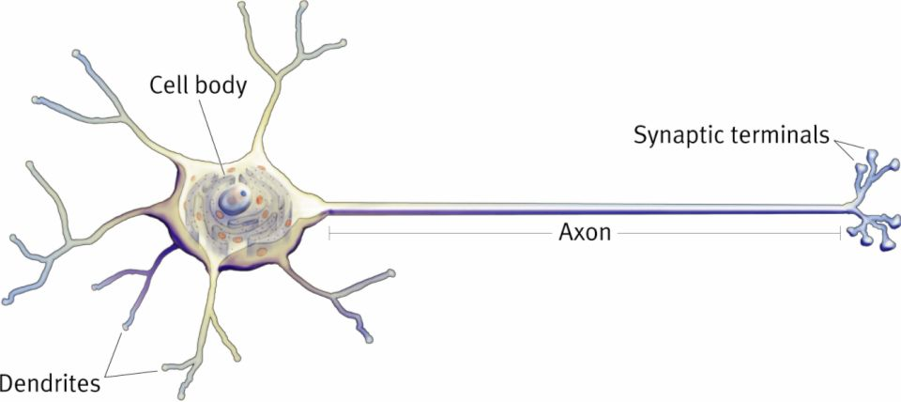
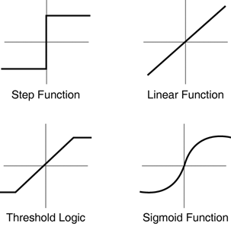
Artificial Neural Network (ANN)
A neuron fires if input signal is above a threshold
The activation function f can take several shapes
b
x₁
w₁
x₂
w₂
Σ
f
y
...
...
w_{n}
x_{n}
f(w₁x₁ + w₂x₂ + ... + w_{n}x_{n} + b) = y
15

Slide 16
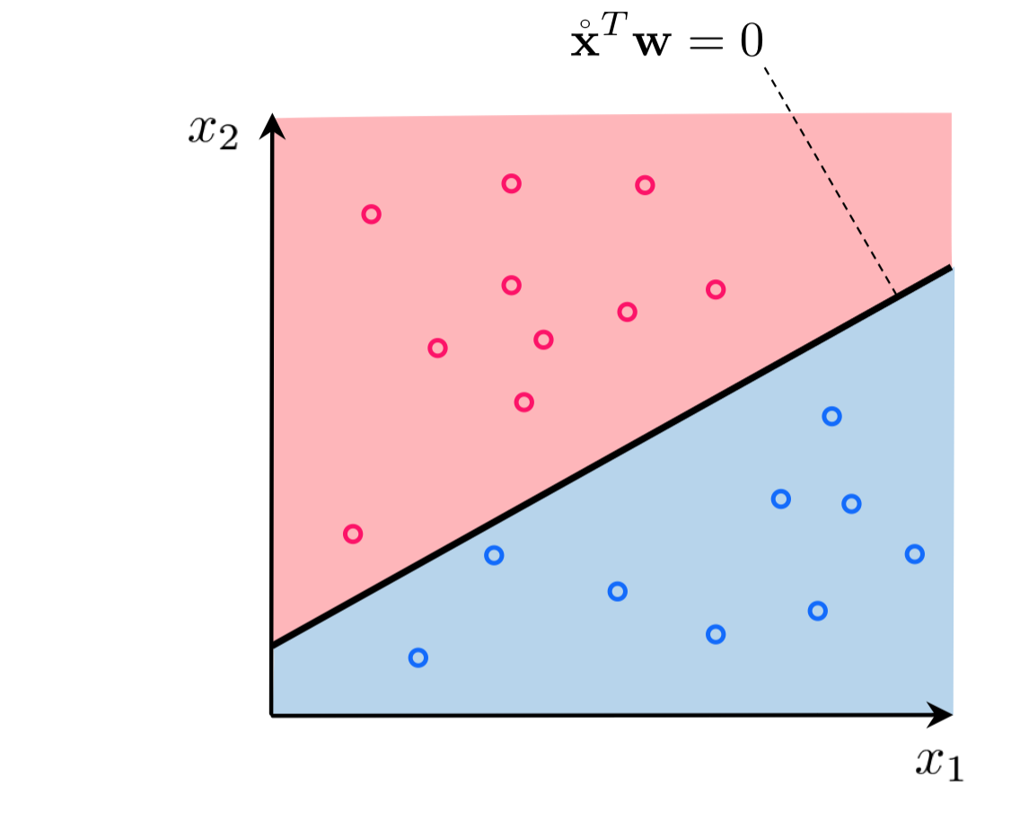
Artificial Neural Network (ANN)
A single neuron can be used to take simple decisions
b
x₁
w₁
Σ
H
y
w₂
x₂
H(w₁x₁ + w₂x₂ + b) = y
16

Slide 17
Artificial Neural Network (ANN)
A single neuron can be used to take simple decisions
Σ
f
w₁
Complex decision making emerges when arranging neurons into networks
w₅
b₃
w₂
x₁
b₁
Σ
f
y
x₂
b₂
w₃
w₄
w₆
Σ
f
17

Slide 18
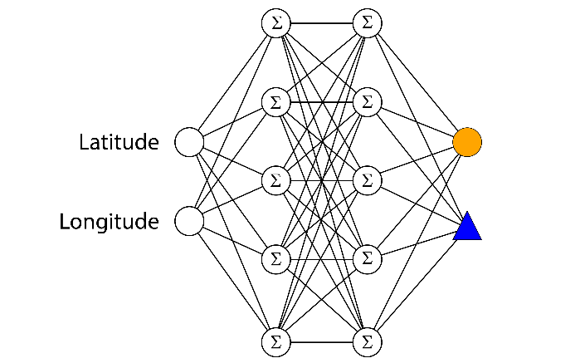
Artificial Neural Network (ANN)
A single neuron can be used to take simple decisions
Complex decision making emerges when arranging neurons into networks
An ANN with one hidden layer can approximate any function
Σ
Σ
Σ
Σ
18

Slide 19
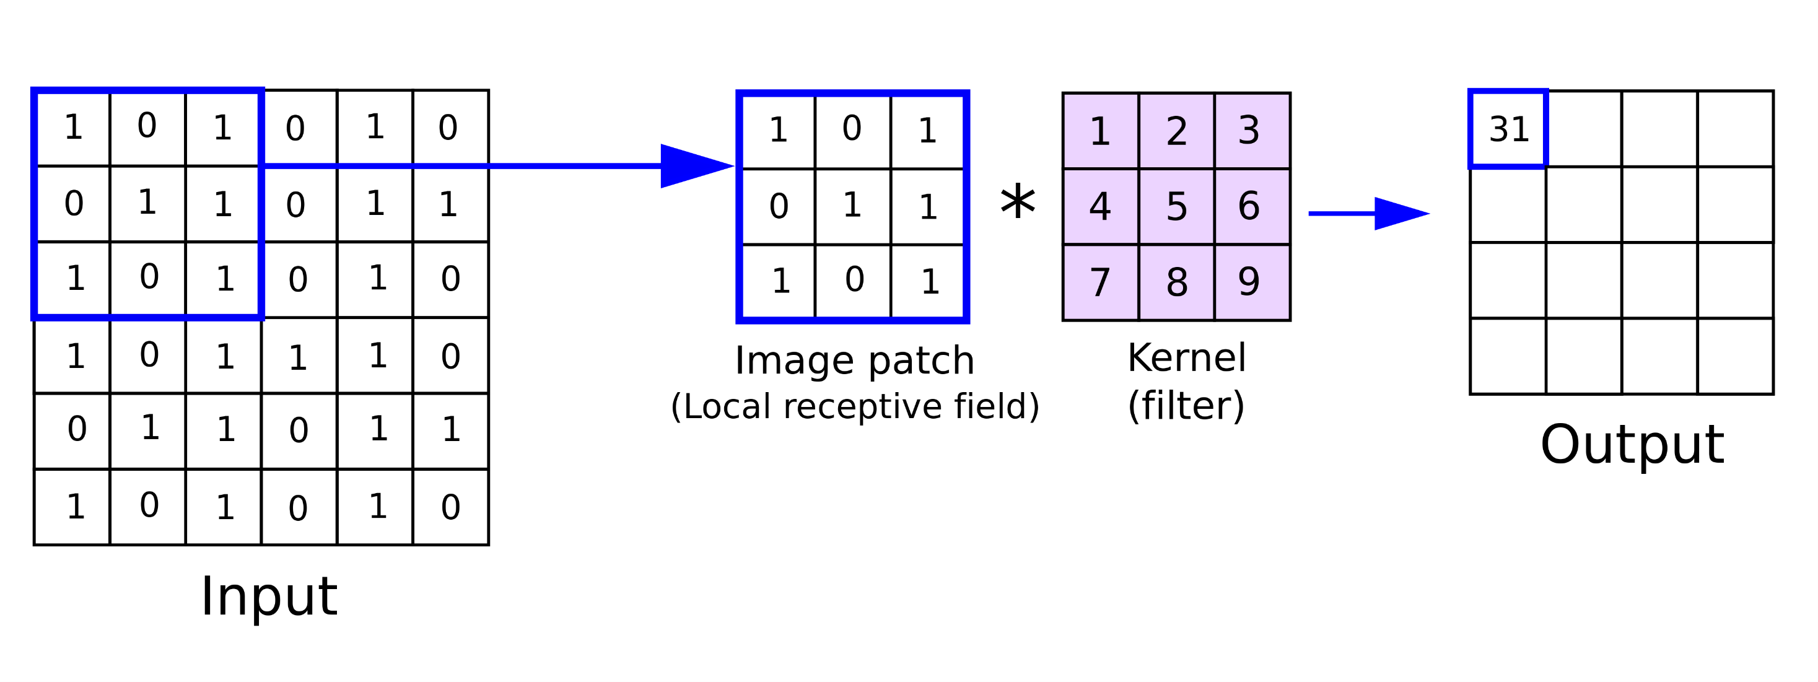
[Extra] Convolutional neural networks (CNN)
Convolution: a mathematical operation, “sliding a kernel” (filter) over the signal.
19

Slide 20


[Extra] Convolutional neural networks (CNN)
Convolution: a mathematical operation, “sliding a kernel” (filter) over the signal.
20

Slide 21
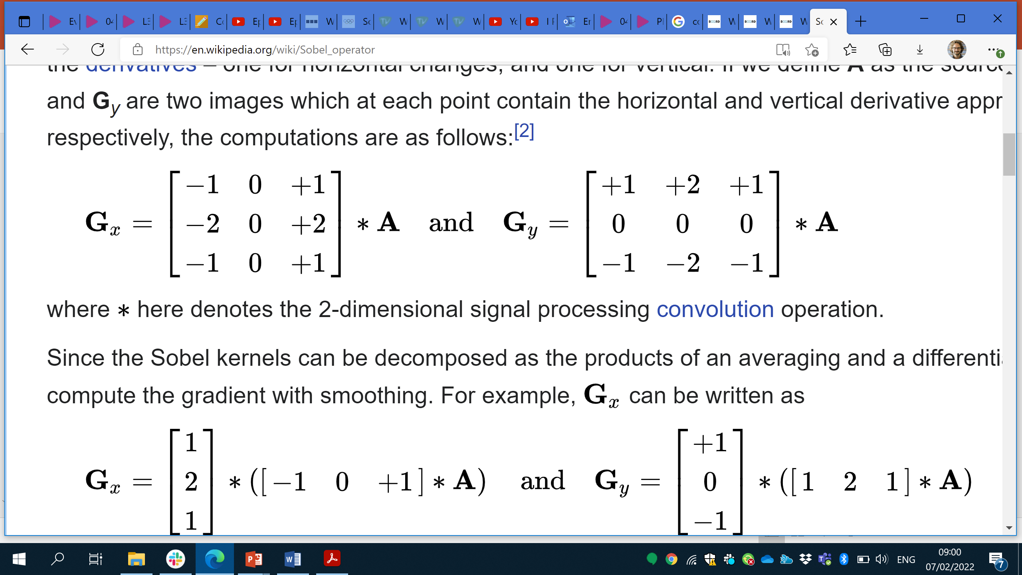
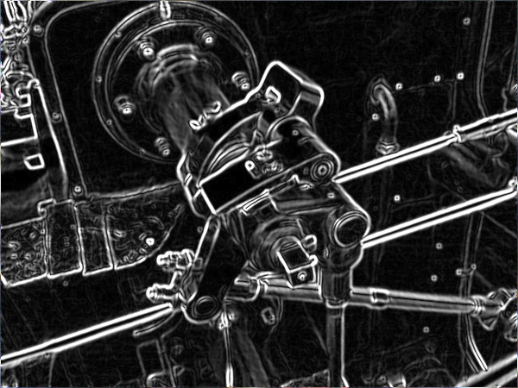
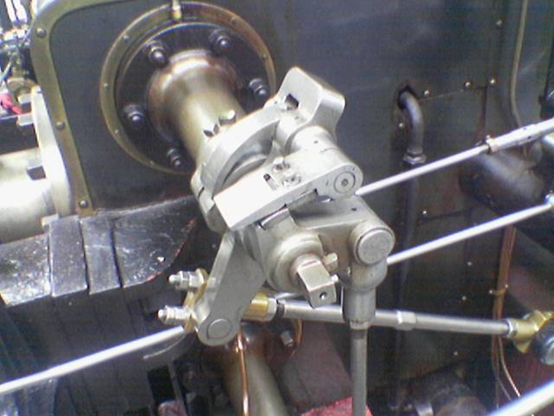
[Extra] Convolutional neural networks
Convolution: a mathematical operation, “sliding a filter” (kernel) over the signal.
Example, edge detection:
and
Convolutional neural network: instead of neurons, has many kernels. Learning = optimising kernel weights
21

Slide 22
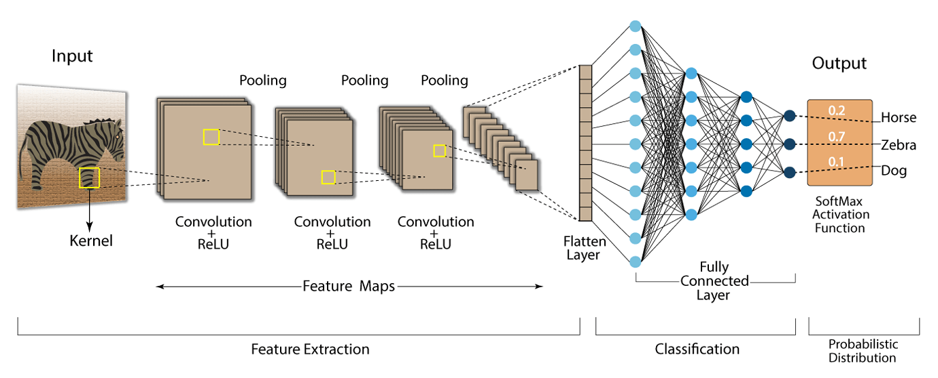
[Extra] Convolutional neural networks
Exploit local correlation in data (e.g. Images, spectra, ...).
Can deal with inputs of arbitrary sizes with less parameters to learn
Problem with neural networks: interpretability
22

Slide 23
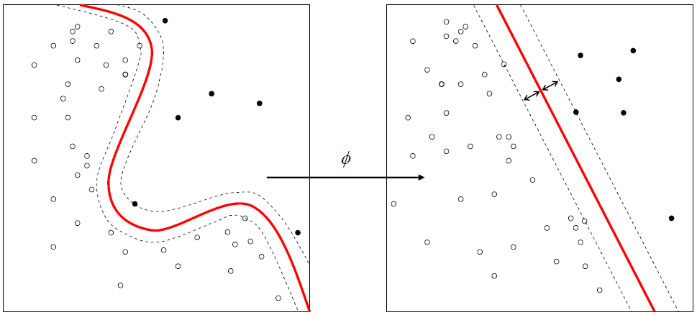
[Extra] Support Vector Machine (SVM)
invented by V. Vapnik et al. in the 1970s in Russia, but only known to the West in 1992
linear classifier finding a hyperplane to separate two class of data
Kernel functions (Φ) used for nonlinear separation
23

Slide 24
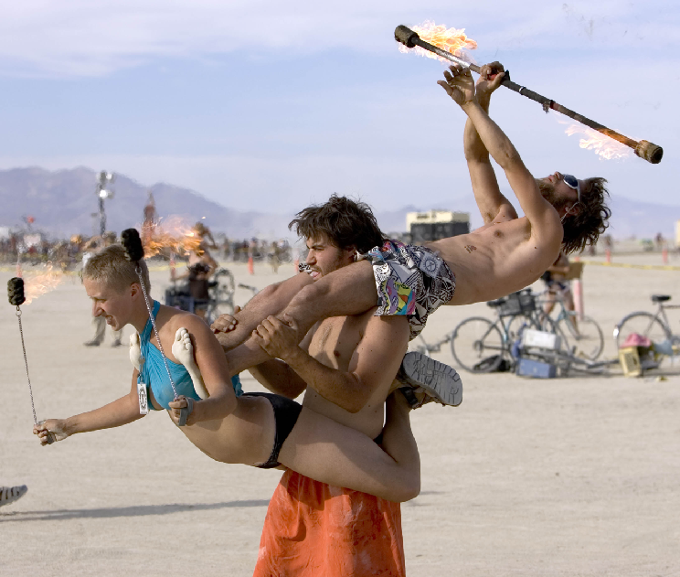
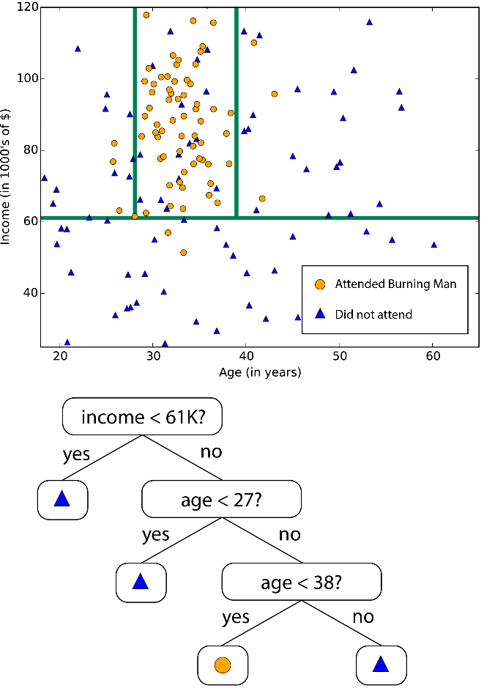
Decision Trees (DT)
Subdivides features space in sectors
Can overfit if space subdivision becomes too fine
azure.microsoft.com/en-us/documentation/articles/machine-learning-algorithm-choice
24

Slide 25
Bootstrap Aggregating (Bagging)
a weighted sum of weak classifiers creates a single strong classifier
Useful when a small change to training set causes large change in the output classifier (“learner is unstable”)
training set D with m examples
D=
1 | 2 | 3 | 4 | 5 | 6 | 7 | 8 | 9
Create N bootstrap samples S drawing m random examples from D with replacement
S[0]=
5 | 1 | 7 | 2 | 7 | 9 | 2 | 6 | 5
→C[0]
S[1]=
9 | 4 | 7 | 1 | 2 | 8 | 9 | 7 | 6
→C[1]
S[2]=
0 | 8 | 2 | 0 | 9 | 7 | 7 | 0 | 1
→C[2]
…
S[N]=
1 | 2 | 3 | 4 | 5 | 6 | 7 | 8 | 9
→C[N]
Training: for every S, build a distinct classifier C using the same learning algorithm
L. Breiman, Bagging Predictors, in Machine Learning, Springer, 1996
25

Slide 26
[Extra] Boosting
a weighted sum of weak classifiers creates a single strong classifier
iteratively add classifiers to a pool, tweaked to give more importance to data misclassified by previous classifiers
Weights based on learners accuracy
26

Slide 27
Random Forests (RF)
Data bagging: creates N decision trees trained on bagged data
Feature bagging: Given M features, every tree learns on m≪M randomly selected features
Classification based on voting of resulting forest
Advantages:
does not overfit
Can handle thousands of features
estimates what variables are important for classification
L. Breiman, Random Forests, Machine Learning, 2001
27

Slide 28
How do I pick the best learning algorithm?
Learning algorithms quality criteria:
accuracy: percentage of correct classification
robustness: handling noise and missing values
efficiency: time to construct and use the model
scalability: efficiency in memory requirements
interpretability: how much the model is understandable
28

Slide 29
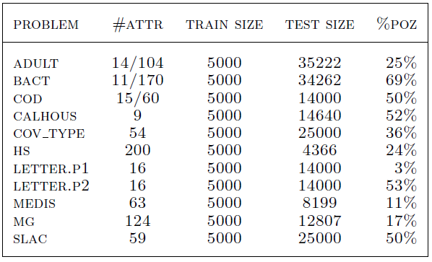
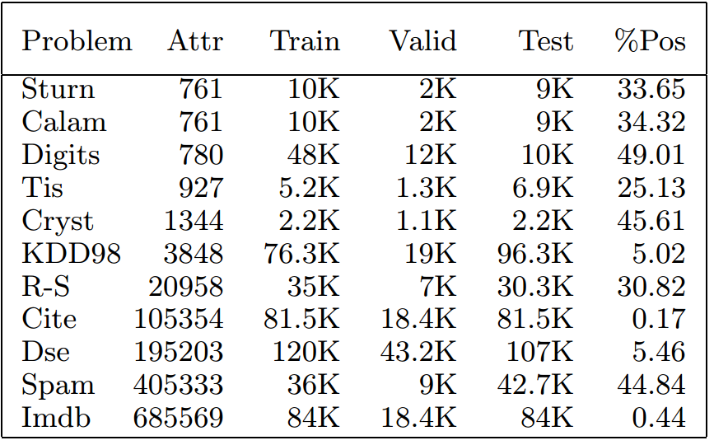
[Extra] Accuracy and robustness benchmark (1)
R. Caruana et al. systematically tested learning algorithms against different datasets
R. Caruana and A. Niculescu-Mizil, An Empirical Comparison of Supervised Learning Algorithm, Proceedings of the 23rd International Conference on Machine Learning, 2006
R. Caruana et al., An Empirical Evaluation of Supervised Learning in High Dimensions, Proceedings of the 25rd International Conference on Machine Learning, 2008
29

Slide 30
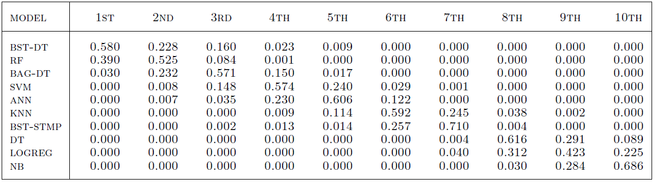
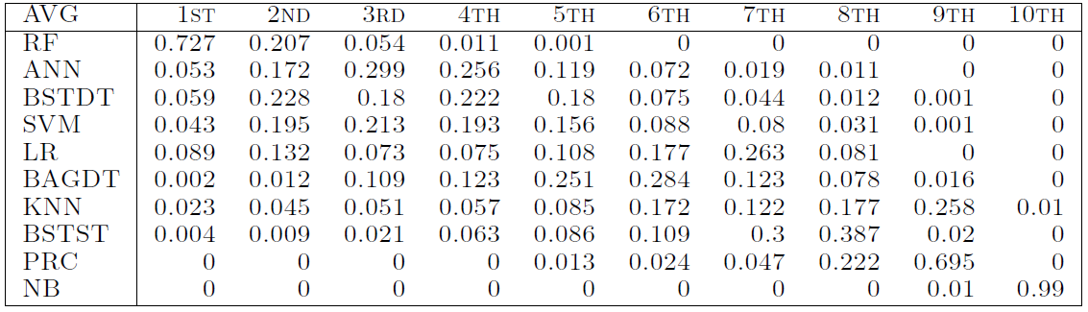
[Extra] Accuracy and robustness benchmark (2)
Bootstrap analysis: all methods learn from of a random training subset, and get ranked by accuracy
Not high dimensional
High dimensional
30

Slide 31
Conclusion
Know what algorithms do, what their limitations are, and how their parameters may affect results
Pick your algorithm depending on the nature of your data
Better data often beats better algorithms
Getting started: consider Python!
31

